Slide 1

Course Id :INT 522

Slide 2
FILE HANDLING

Slide 3
I INTRODUCTION

Slide 4
FILES
Data is very important. Every organization depends on its data for continuing its business operations. If the data is lost, the organization has to be closed.
This is the reason computers are primarily created for handling data, especially for storing and retrieving data. In later days, programs are developed to process the data that is stored in the computer.

Slide 5
FILES
To store data in a computer, we need files. For example, we can store employee data like employee number, name and salary in a file in the computer and later use it whenever we want.
Similarly, we can store student data like student roll number, name and marks in the computer. In computers’ view, a file is nothing but collection of data that is available to a program. Once we store data in a computer file, we can retrieve it and use it depending on our requirements.

Slide 6
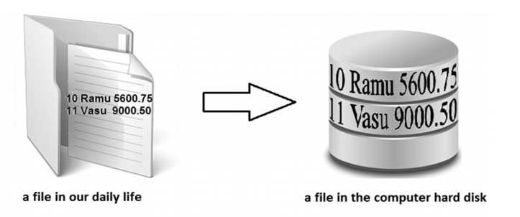

Slide 7
ADVANTAGES OF STORING A DATA IN A FILE
When the data is stored in a file, it is stored permanently. This means that even though the computer is switched off, the data is not removed from the memory since the file is stored on hard disk or CD. This file data can be utilized later, whenever required.
It is possible to update the file data. For example, we can add new data to the existing file, delete unnecessary data from the file and modify the available data of the file. This makes the file more useful.

Slide 8
ADVANTAGES OF STORING A DATA IN A FILE
Once the data is stored in a file, the same data can be shared by various programs. For example, once employee data is stored in a file, it can be used in a program to calculate employees’ net salaries or in another program to calculate income tax payable by the employees.
Files are highly useful to store huge amount of data. For example, voters’ list or census data.

Slide 9
II TYPES OF FILES

Slide 10
TYPES OF FILES
In Python, there are two types of files.
They are:
Text files
Binary files
Text files store the data in the form of characters. For example, if we store employee name “Ganesh”, it will be stored as 6 characters and the employee salary 8900.75 is stored as 7 characters.
Text files are used to store characters or strings.

Slide 11
TYPES OF FILES
Binary files store entire data in the form of bytes, i.e. a group of 8 bits each. For example, a character is stored as a byte and an integer is stored in the form of 8 bytes (on a 64 bit machine). When the data is retrieved from the binary file, the programmer can retrieve the data as bytes.
Binary files can be used to store text, images, audio and video. Image files are generally available in .jpg, .gif or .png formats.
We cannot use text files to store images as the images do not contain characters.

Slide 12
TYPES OF FILES
On the other hand, images contain pixels which are minute dots with which the picture is composed of.
Each pixel can be represented by a bit, i.e. either 1 or 0. Since these bits can be handled by binary files, we can say that they are highly suitable to store images. It is very important to know how to create files, store data in the files and retrieve the data from the files in Python

Slide 13
III READ A FILE

Slide 14
OPENING A FILE
file = open("file1.txt","rb")
print(file)

Slide 15
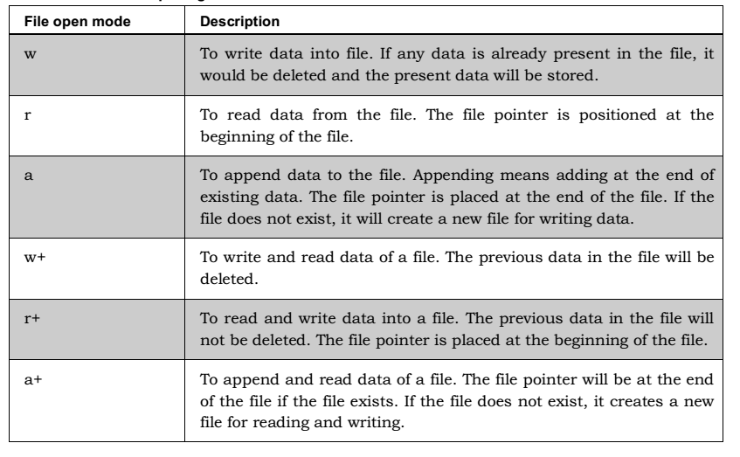
MODES OF FILES

Slide 16
IV WRITING A DATA INTO A FILE

Slide 17
(a) write() method
The write method is used to write a string to an already opened file.
String may include members, special characters, other symbols.
f = open('file1.txt', 'w')
#enter characters from keyboard
str = input('Enter text:')
#write the string into file
f.write(str)
#closing the file
f.close()

Slide 18
writelines() method
writelines() method is used to write a list of strings.
f = open('file1.txt', 'w’)
lines=["hello world,","welcome to the world of python"]
f.writelines(lines)
#closing the file
f.close()
print("data written to file")

Slide 19
V APPEND DATA TO FILE

Slide 20
append() method
To append a file, you must open it using ‘a’ or ‘ab’ mode depending on whether it is a text or a binary file.
f = open('file1.txt', 'a’)
f.write("\n my name is dev")
#closing the file
f.close()
print("data written to file")

Slide 21
V READ , READLINE, READLINES METHODS

Slide 22
(a) read() method
This method is used to read a string from an already opened file.
f = open('file1.txt', 'r’)
print(f.read(10))
f.close()

Slide 23
(b) readline() method
This method is used to read a single line from the file.
f = open('file1.txt', 'r’)
print(f.readline())
print(f.readline())
print(f.readline())
f.close()

Slide 24
(c) readlines() method
This method is used to read all the lines in a file.
f = open('file1.txt', 'r’)
print(f.readlines())
f.close()

Slide 25
VI DISPLAY THE CONTENTS OF A FILE USING LOOP

Slide 26
Display the contents of a file using FOR loop
f = open('file1.txt', 'r’)
for line in f:
print(line)
f.close(

Slide 27
VII OPENING A FILE USING with KEYWORD

Slide 28
With Keyword
with open ("file1.txt","rb") as file:
for line in file:
print(line)
file.close()
with open ("file1.txt","r") as file:
for line in file:
print(line)
file.close()

Slide 29
VIII SPLITTING WORDS

Slide 30
split() function
This function is used to split the strings into words.
with open ("file1.txt","b") as file:
line= file.readline()
words= line.split()
print(words)

Slide 31
IX EXCERCISE

Slide 32
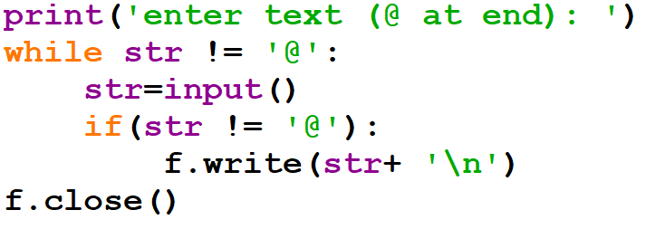
1. What is the output of the Code?

Slide 33
Program 1
Write a program that accepts filename as an input from the user. Open the file and count the number of times a character appears in the file

Slide 34
Program 2
Write a program that reads data from a file and calculates the percentage of vowels and consonants

Slide 35
Program 3
Write a program to count number of lines, words, characters in a text file

Slide 36
X RENAMING AND DELETING

Slide 37
rename() method
Rename () method takes two arguments, the current filename and the new filename.
Import os
os.rename(“fileo.txt”,”filen.txt”)
print(“file renamed”)

Slide 38
remove() method
Remove() method is used to delete file.
Import os
os.remove(“file1.txt”)
print(“file deleted”)

Slide 39
XI PICKLE

Slide 40
PICKLE
Text files are useful when we do not want to perform any calculations on the data. What happens if we want to store some structured data in the files? For example, we want to store some employee details like employee identification number (int type), name (string type) and salary (float type) in a file. This data is well structured and got different types. To store such data, we need to create a class Employee with the instance variables id, name and sal
as shown in next slide.

Slide 41
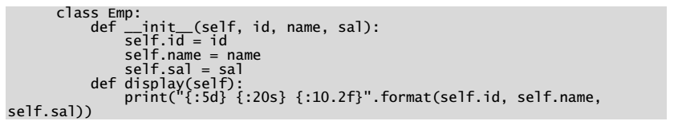
PICKLE

Slide 42
Pickle
In the previous program, we create an object to class and store actual data into that object. Later, this object should be stored into a binary file in the form of bytes. This is called pickle or serialization.
So, let’s understand that pickle is a process of converting a class object into a byte stream so that it can be stored into a file. This is also called object serialization.

Slide 43
Pickle
Pickling is done using the dump() method of ‘pickle’ module as:
pickle.dump(object, file)
The preceding statement stores the ‘object’ into the binary ‘file’. Once the objects are stored into a file, we can read them from the file at any time.

Slide 44
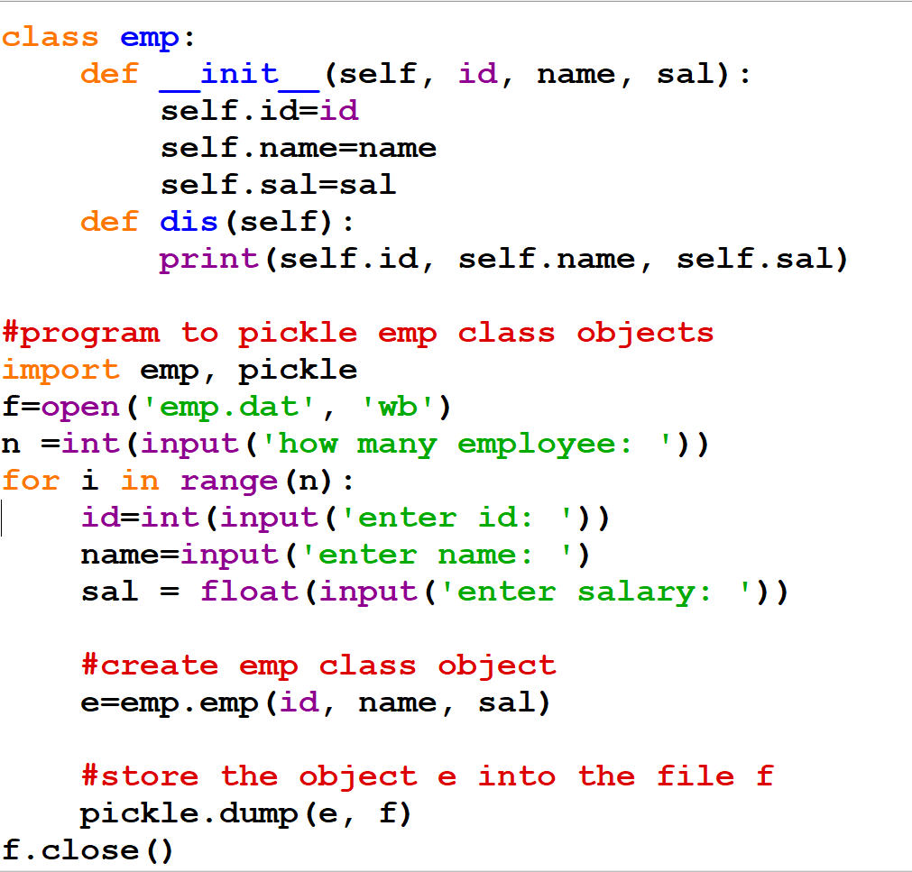
Pickle Implementation

Slide 45
Unpickle
Unpickle is a process whereby a byte stream is converted back into a class object. It means, unpickling represents reading the class objects from the file.
Unpickling is also called desearialization.
Unpickling is done using the load() method of ‘pickle’ module as:
object = pickle.load(file)
Here, the load() method reads an object from a binary ‘file’ and returns it into ‘object’. Let’s remember that pickling and unpickling should be done using binary files since they support byte streams. The word stream represents data flow. So, byte stream represents flow of bytes.

Slide 46
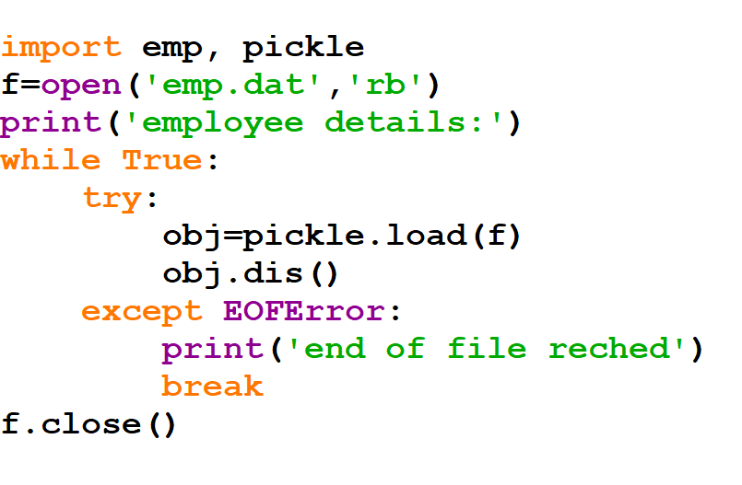
Unpickle Implementation

Slide 47
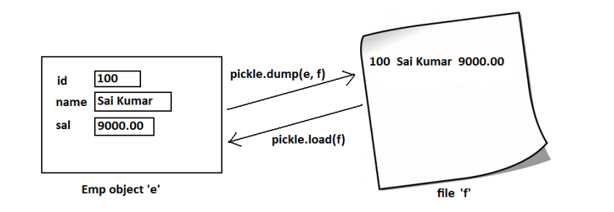
Picking and Unpickling a class object

Slide 48
XII seek() AND tell() method

Slide 49
tell() method
We know that data in the binary files is stored in the form of bytes. When we conduct reading or writing operations on a binary file, a file pointer moves inside the file depending on how many bytes are written or read from the file.
For example, if we read 10 bytes of data from a file, the file pointer will be positioned at the 10th byte so that it is possible to continue reading from the 11th byte onwards.
To know the position of the file pointer, we can use the tell() method.

Slide 50
tell() method
It returns the current position of the file pointer from the beginning of the file. It is used in the form: n = f.tell()
Here, ‘f’ represents file handler or file object. ‘n’ is an integer that represents the byte position where the file pointer is positioned. In case, we want to move the file pointer to another position, we can use the seek() method.

Slide 51
seek () method
This method takes two arguments: f.seek(offset, fromwhere)
Here, ‘offset’ represents how many bytes to move. ‘fromwhere’ represents from which position to move.
For example, ‘fromwhere’ can be 0, 1 or 2. Here, 0 represents from the beginning of the file, 1 represents from the current position and 2 represents from the ending of the file. The default value of ‘fromwhere’ is 0, i.e. beginning of the file.

Slide 52
seek() method
f.seek(10) #same as f.seek(10, 0)
This will move the file pointer to the 11th byte (i.e. 10+1) from the beginning of the file (0 represents beginning of the file). So, any reading operation will read data from 11th byte onwards.
f.seek(-10, 2)
This will move the file pointer to the 9th byte (-10+1) from the ending of the file (2 represents ending of the file). The negative sign before 10 represents moving back in the file.

Slide 53
XIII RANDOM ACCESSING OF BINARY FILES USING mmap

Slide 54
mmap
mmap – ‘memory mapped file’ is a module in Python that is useful to map or link to a binary file and manipulate the data of the file as we do with the strings.
It means, once a binary file is created with some data, that data is viewed as strings and can be manipulated using mmap module. The first step to use the mmap module is to map the file using the mmap() method as:
mm = mmap.mmap(f.fileno(), 0)
This will map the currently opened file (i.e. ‘f’) with the file object ‘mm

Slide 55
Please observe the arguments of mmap() method.
The first argument is ‘f.fileno()’ .
This indicates that fileno() is a handle to the file object ‘f’.
This ‘f’ represents the actual binary file that is being mapped. The second argument is zero( 0) represents the total size of the file should be considered for mapping. So, the entire file represented by the file object ‘f’ is mapped in memory to the object ‘mm’. This means, ‘mm’ will now onwards behave like the file ‘f’.

Slide 56
mmap
Now, we can read the data from the file using read() or readline() methods as:
print(mm.read()) #displays entire file data
print(mm.readline()) #displays the first line of the file

Slide 57
mmap
We can retrieve data from the file using slicing operator as: print(mm[5:]) #display from 5th byte till the end
print(mm[5:10]) #display from 5th to 9th bytes
It is also possible to modify or replace the data of the file using slicing as:
mm[5:10] = str #replace from 5th to 9th characters by string ‘str’

Slide 58
mmap
We can also use find() method that returns the first position of a string in the file as:
n = mm.find(name)
#return the position of name in the file
We can also use seek() method to position the file pointer to any position we want as:
mm.seek(10, 0)
#position the file pointer to 10th byte from beginning of file

Slide 59
XIV ZIPPING AND UNZIPPING OF FILES

Slide 60
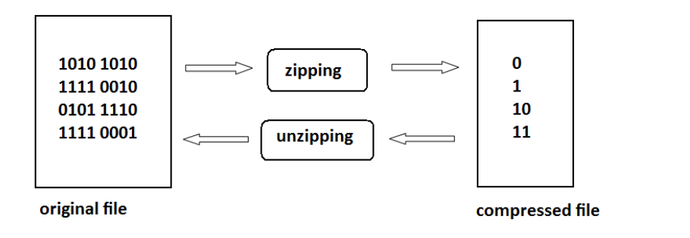

Slide 61
ZIPPING AND UNZIPPING OF FILES
We know that some softwares like ‘winzip’ provide zipping and unzipping of file data.
In zipping the file contents, following two things could happen:
The file contents are compressed and hence the size will be reduced.
The format of data will be changed making it unreadable.

Slide 62
ZIPPING AND UNZIPPING OF FILES
While zipping a file content, a zipping algorithm (logic) is used in such a way that the algorithm first finds out which bit pattern is most often repeated in the original file and replaces that bit pattern with a 0. Then the algorithm searches for the next bit pattern which is most often repeated in the input file.
In its place, a 1 is substituted. The third repeated bit pattern will be replaced by 10, the fourth by 11, the fifth by 100, and so on. In this way, the original bit patterns are replaced by lesser number of bits. This file with lesser number of bits is called ‘zipped file’ or ‘compressed file’.

Slide 63
ZIPPING AND UNZIPPING OF FILES
In Python, the module zipfile contains ZipFile class that helps us to zip or unzip a file contents. For example, to zip the files, we should first pass the zip file name in write mode with an attribute ZIP_DEFLATED to the ZipFile class object as:
f = ZipFile('test.zip', 'w', ZIP_DEFLATED)
Here, ‘f’ is the ZipFile class object to which test.zip file name is passed. This is the zip file that is created finally. The next step is to add the filenames that are to be zipped, using write() method as:
f.write('file1.txt’)
f.write('file2.txt')

Slide 64
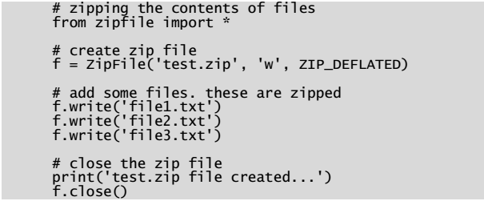
Python program to compress the contents of files

Slide 65
extractall() method
In the previous program, we assumed that the three files: file1.txt, file2.txt and file3.txt are already available in the current directory where this program is run.
To unzip the contents of the compressed files and get back their original contents, we can use ZipFile class object in read mode as:
z = ZipFile('test.zip', 'r’)
Here, test.zip is the filename that contains the compressed files.
To extract all the files from the zip file object ‘z’, we can use the extractall() method as:
z.extractall()
.

Slide 66
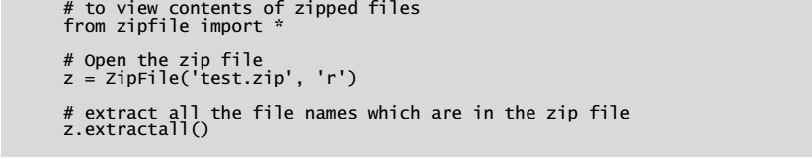
Python program to unzip the contents of the files that are available in a zip file

